Slide 1
SYNOPSIS/RESEARCH PROPOSAL
IDS FOR HYBRID CLOUD
PRESENTED BY:
Mushtaq Ahmad Dar
M.Tech-3rd Semester

Slide 2
ABSTRACT
INTRODUCTION
LITERATURE SURVEY
MOTIVATION
OBJECTIVE
RESEARCH METHODOLOGY
DATA SET
TOOLS USED
CONCLUSION
REFERENCES
CONTENTS

Slide 3
ABSTRACT
Security of valuable information is always a very essential issue for modern digital world. Intrusion Detection System (IDS) and many security techniques are widely used against cyber attacks. Data mining and machine learning methods have also been used by researchers to obtain high detection rate and low false alarm rate. Proposed work aims to design and development of an approach for improve cyber attack detection system using cloud.

Slide 4
INTRODUCTION
An Intrusion detection system examines all internal and external network activities or attacks and identifies suspicious design that may point out the system attack or a network from someone attempting to break into the security or compromise a system .
Due to the distributed nature of cloud computing, cloud computing environments are easy targets for invaders looking for possible susceptibility to exploit.

Slide 5
LITERATURE SURVEY
AUTHOR | TITLE OF PAPER | APPROACH | METHOD | ACCURACY LEVEL
M.M.Hassan Vol.4, No.2, pp.35-47 [1] | Current Studies on Intrusion Detection System, Genetic Algorithm and Fuzzy Logic | Intrusion Detection System | Genetic Algorithm and Fuzzy Logic | Expensive with success rate of 78%
Dr. A. D. Gawande Research,Vol.1,ISSN 2277-8616, 2012 [2] | Intrusion Detection System for Cloud Computing | Intrusion Detection System | Fuzzy Logic | Success rate of 80% for public cloud

Slide 6
LITERATURE SURVEY
SERVICES AND DEPLOYEMENT | IDS USED | PROFECIENCY/ACCURACY
AWS | HIDS | 87%
GOOGLE DOCS | NIDS | 95%
AZURE | HIDS | 97%
(CIC)ISCX-IDS-2012 | IDS | 82%

Slide 7
MOTIVATION
TO LEARN HOW DETECTORS WORK , MOTIVATED ME TO GO FOR THE RESEARCH OF IDS IN HYBRID CLOUD.
THE FOCUS OF MY RESEARCH RELIES MAINLY ON DETECTION ALGORITHM AND ITS IMPLEMENTATION USING AI/TOOL.

Slide 8
OBJECTIVE:
1. TO WORK FOR HYBRID INTRUSION DETECTION METHOD
2. EVALUATE THE EFFECTIVENESS OF ALGORITHM
1. REGISTRATION STAGE
2. SIGNATURE ANALYSIS STAGE
3. ANOMALY ANALYSIS STAGE.

Slide 9
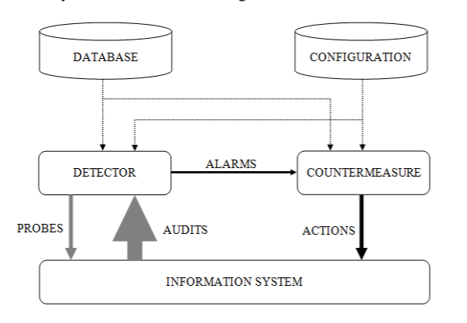
RESEARCH METHODOLOGY

Slide 10
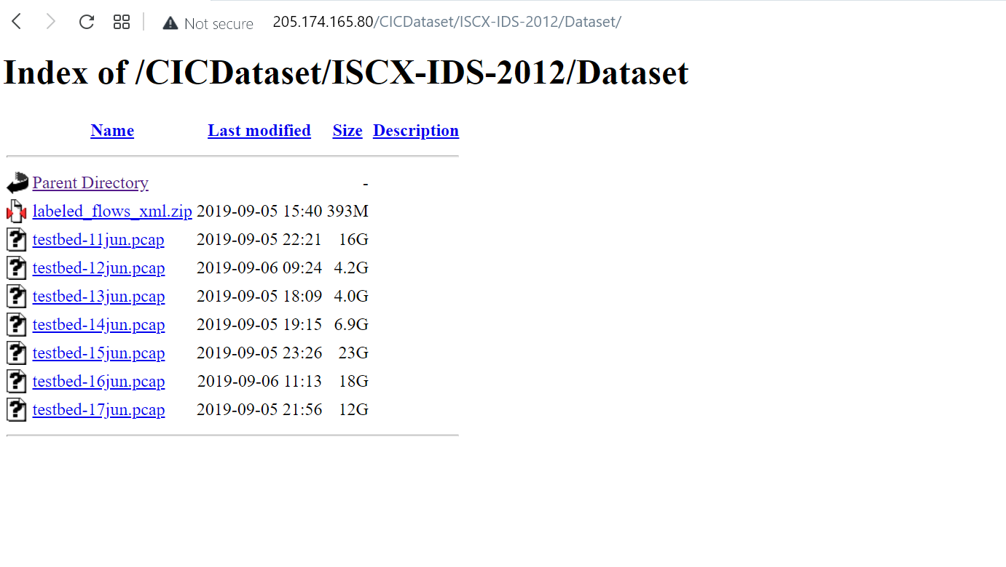
DATA SET

Slide 11
ALGORITHM USED
The most common Shallow Learning algorithms used for IDS are Decision Tree, K-Nearest Neighbor (KNN), Artificial Neural Network (ANN), Support Vector Machine (SVM), K-Mean Clustering, Fast Learning Network, and Ensemble Methods

Slide 12
TOOLS USED
Hardware:
PGPA
SOFTWARE:
USE OF AI(ML)
Snort 3
SURICATA

Slide 13
EXECUTION OF IMPLEMENTED WORK
The experimental steps that will include for the Detection system:-
1. Create New Resource: Machine Learning Analytics solution.
2. Import/Upload the dataset.
3. Pre-process the dataset. Data pre-processing can also be done using modules written ML.
4. Randomly split and partition the data into 70% training and 30% testing, using the ‘Split Data’ module.
5. Identify categorical attributes and cast them into categorical features using the ‘Edit Metadata’ module.
6. Convert to Indicator Values module to convert columns that contain categorical values which can more easily be used as features.
7. Select Columns in Dataset those are relevant
8. Apply Ensemble Method
9. Apply Machine Learning Algorithm to Train the model.
10. Now Score and Evaluate the Model. The ‘Evaluate model’ also visualizes the results through confusion matrix.

Slide 14
CONCLUSION
By joining much more principle, the effectiveness of the method can be enhanced to discover an Intrusion in a network.
By improving the values based upon the limitation of time the implementation of the method can be enhanced.

Slide 15
References
M.M.M.Hassan,” Current Studies on Intrusion Detection System, Genetic Algorithm and Fuzzy Logic”, International Journal of Distributed and Parallel Systems, Vol.4, No.2, pp.35-47.
Ms. Parag K Shelke, Ms. Sneha Sontakke and Dr. A. D. Gawande, “Intrusion Detection System for Cloud Computing”, International Journal of Scientific & Technology Research,Vol.1,ISSN 2277-8616, 2012.
Hassen Mohammed Alsafi, Wafaa Mustafa Abduallah and Al-Sakib khan Pathan,”IDPS: An integrated Intrusion Handling Model for Cloud Computing Environment, International Journal of Computing and Information Technology (IJCIT), 2012.
Ms. Parag K Shelke, Ms. Sneha Sontakke and Dr. A. D. Gawande, “Intrusion Detection System for Cloud Computing”, International Journal of Scientific & Technology Research,Vol.1,ISSN 2277-8616, 2012.

Slide 16
Thank you

